Slide 1
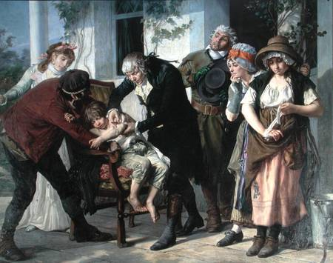
Enlightenment PPT #1: Philosophy in the Age of Reason
The Scientific Revolution changed the way people looked at the world
See a problem? Change it!!!
Scientific Success = power of human reason
NATURAL LAW = rules discoverable by reason:
Gravity
Magnetism

Slide 2
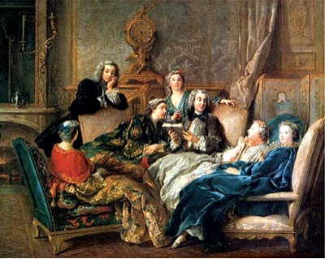
NOW …..Use Natural Law to understand social, economic and political problems
Solve the problems of society
This Revolution in thinking =
THE ENLIGHTENMENT

Slide 3
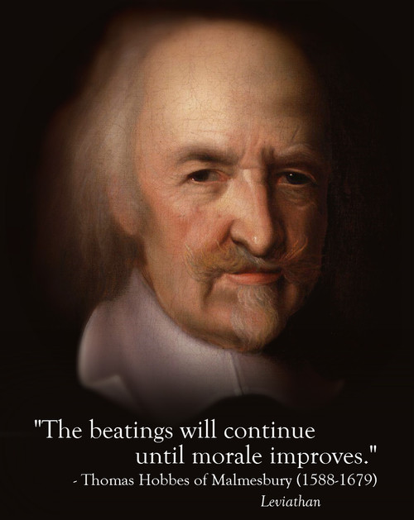
Thomas Hobbes –
People are naturally cruel, greedy & selfish
Must be strictly controlled or they rob, fight & oppress
People must enter a SOCIAL CONTRACT = give up freedom for organized society
Absolute Monarch necessary
“The Life of man is solitary, poor, nasty, brutish, and short.” Thomas Hobbes

Slide 4
John Locke –
People are basically reasonable & moral
Had NATURAL RIGHTS that belonged to all humans from birth: life, liberty, property
Government formed to protect natural rights
Government must be limited & accepted by all people
Government obligated to people – people have right to overthrow the government
Ideas to influence American Revolution: Benjamin Franklin, Thomas Jefferson & James Madison
Locke’s ideas of revolution eventually spread across Europe and Latin America

Slide 5
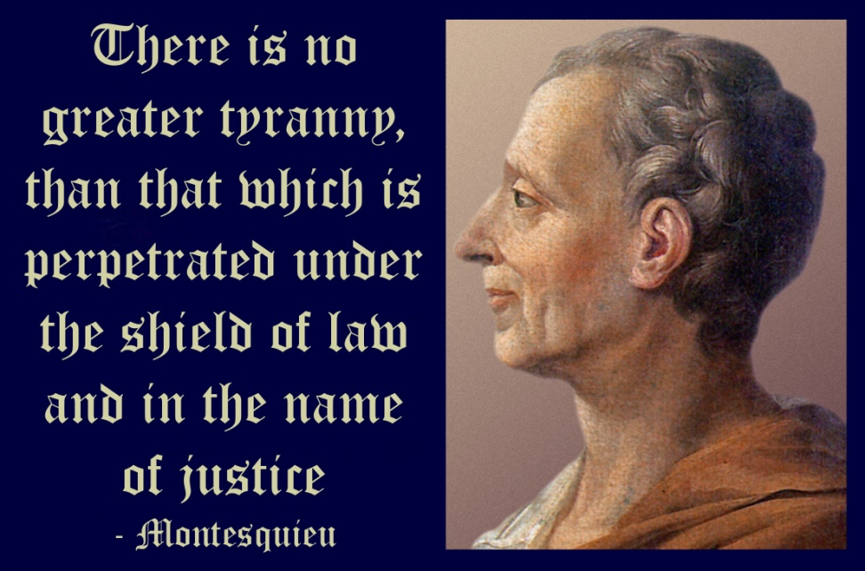
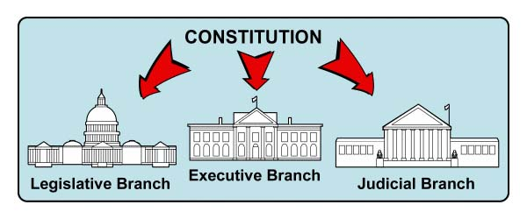
Montesquieu - Advances idea of Separation of Powers
Best way to protect liberty = divide functions & powers into three branches
Legislative, executive, judicial
Creates checks & balances
Ideas helped create the United States Constitution

Slide 6
Voltaire - Defends Freedom of Thought
Most famous of the philosophes
“My trade is to say what I think.” Voltaire
Used biting wit – exposed abuses of his day
battled inequality, injustice, superstitions, the slave trade & religious prejudice
Outspoken – offended French government & Catholic Church
Imprisoned – forced into exile
His books, outlawed & burned
Never gave up his beliefs
To learn who rules over you, simply find out who you are not allowed to criticize. Voltaire

Slide 7
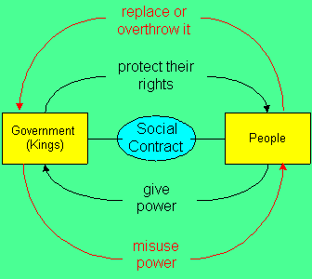
Rousseau – promotes The Social Contract
Believed people were naturally good
Corrupted by evils of society – especially inequality
1762 – wrote The Social Contract
Government control should be minimal
Governments must be freely elected
Good of community above good of individual
Hatred of all forms of political oppression
Fanned flames of revolt

Slide 8
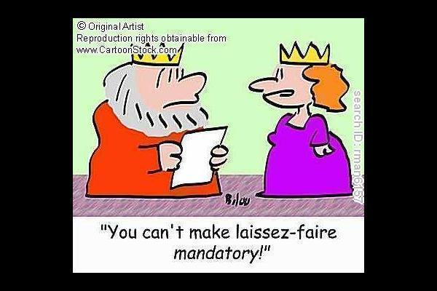
French thinkers – Physiocrats – focused on economic reforms
Laissez Faire replaces Mercantilism
Rejected Mercantilism which required government to regulate economy to achieve favorable balance of trade
Urged policy of laissez faire – allowing business to operate with little or no government interference
Supported free trade – opposed tariffs

Slide 9
Scottish Economist Adam Smith argues for a Free Market
Wrote The Wealth of Nations – argued that the free market should be allowed to regulate business activity
Wages, trade, profits all tied to market forces of Supply & Demand
Wherever there is a demand for goods or services suppliers would try to meet that demand in order to make profits

Slide 10
Church & Government attacked writers –
Censorship = restricting access to ideas and information
Books were banned & burned
Writers were imprisoned
Many writers disguised their work as fiction to avoid censorship
The tales exposed corruption & hypocrisy in society

